Slide 1
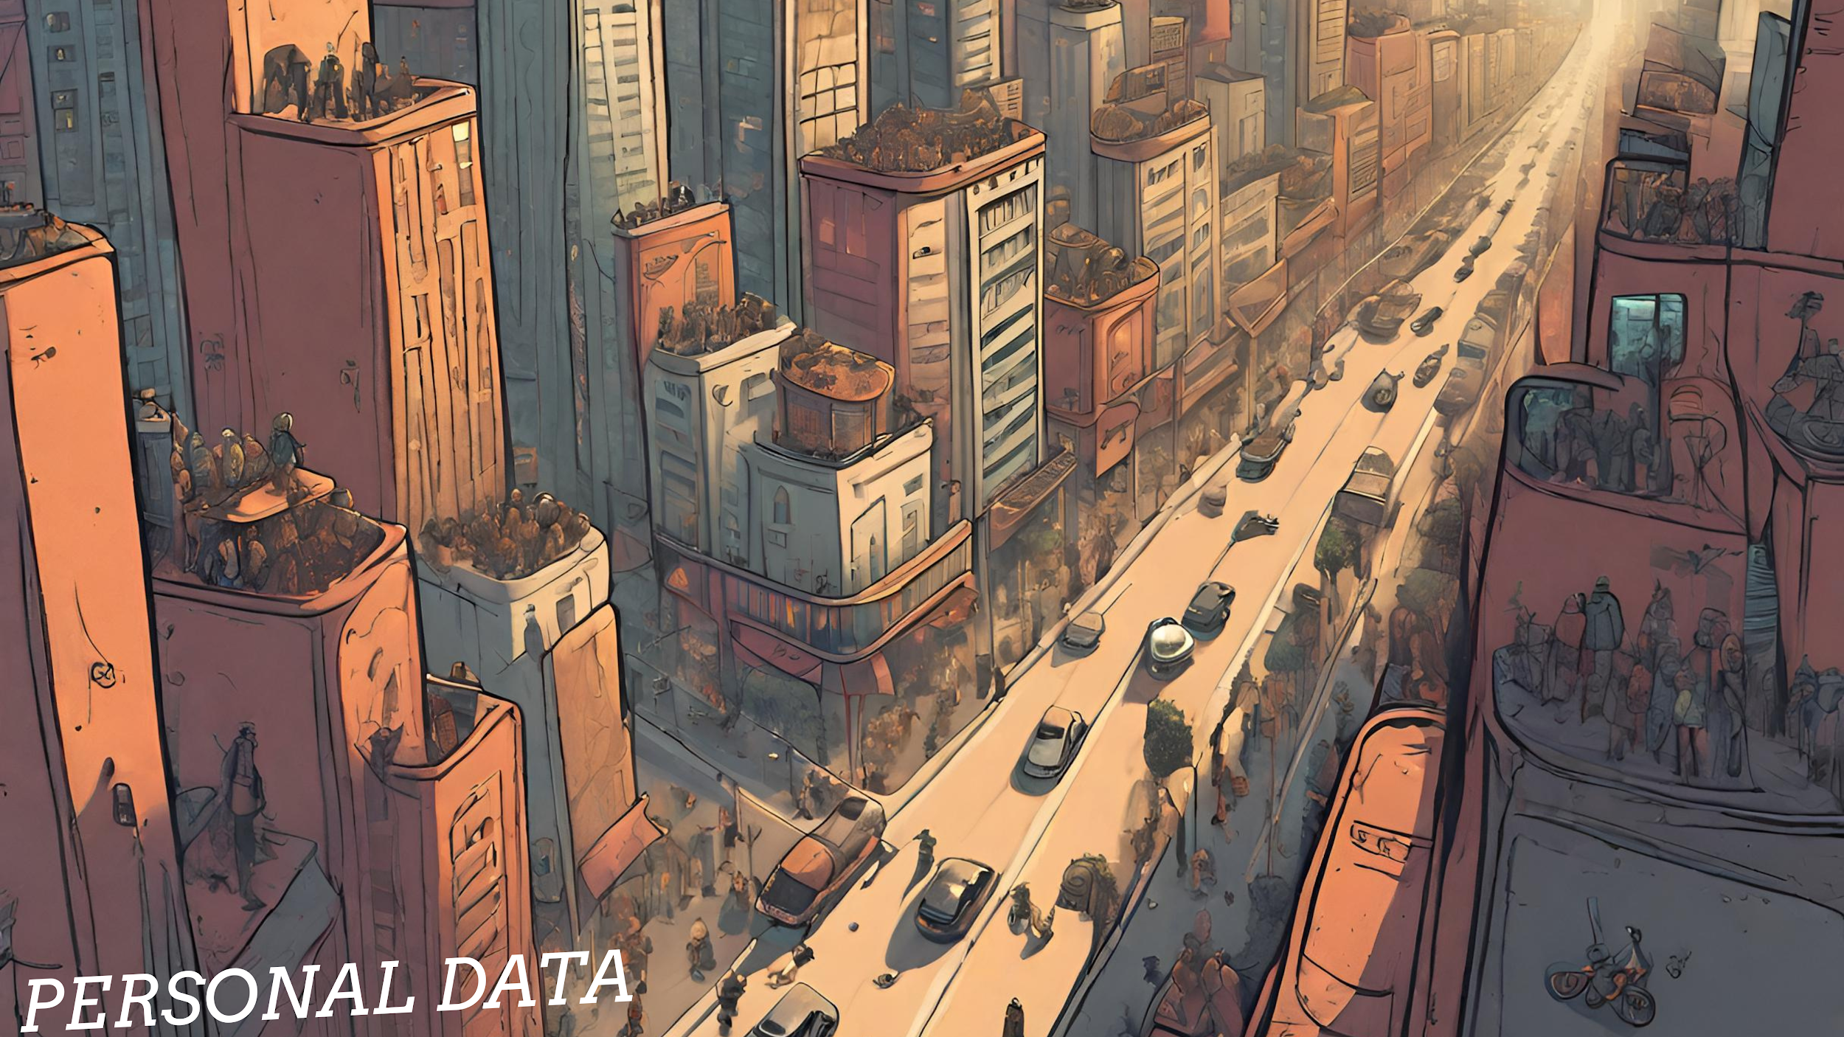

Slide 2
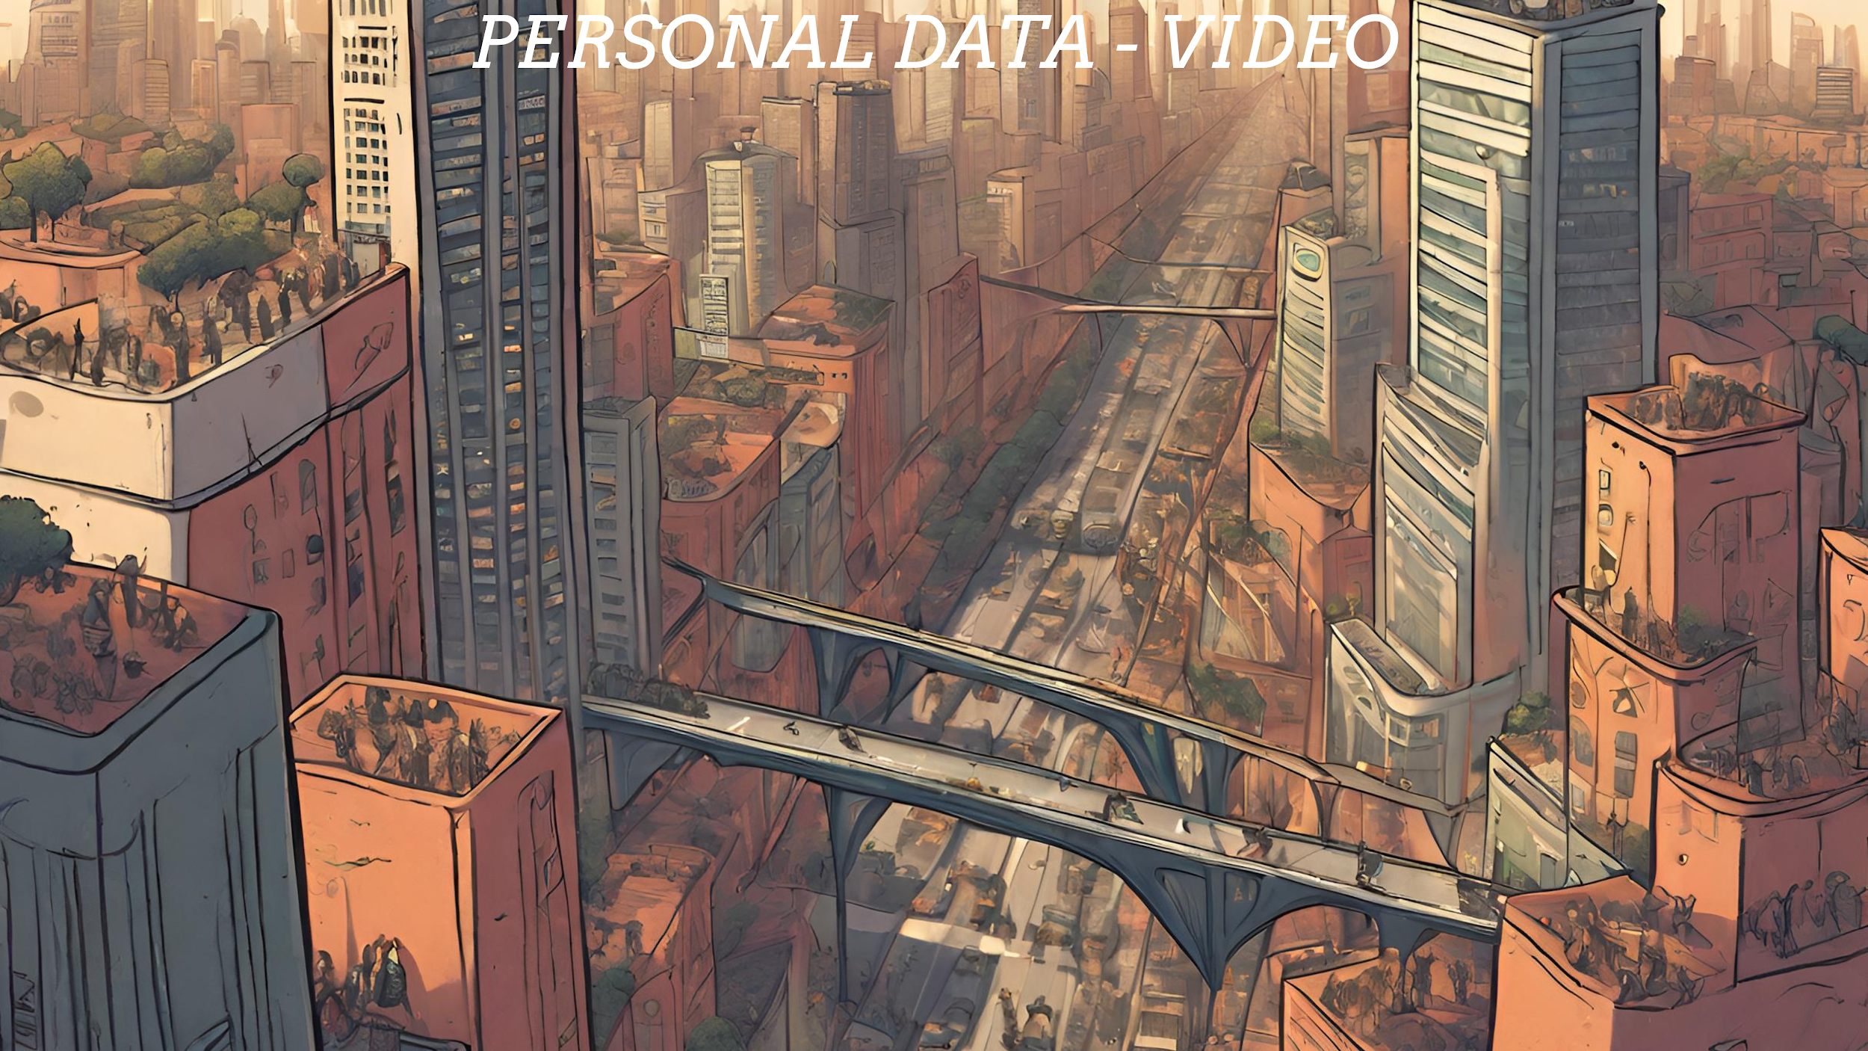

Slide 3
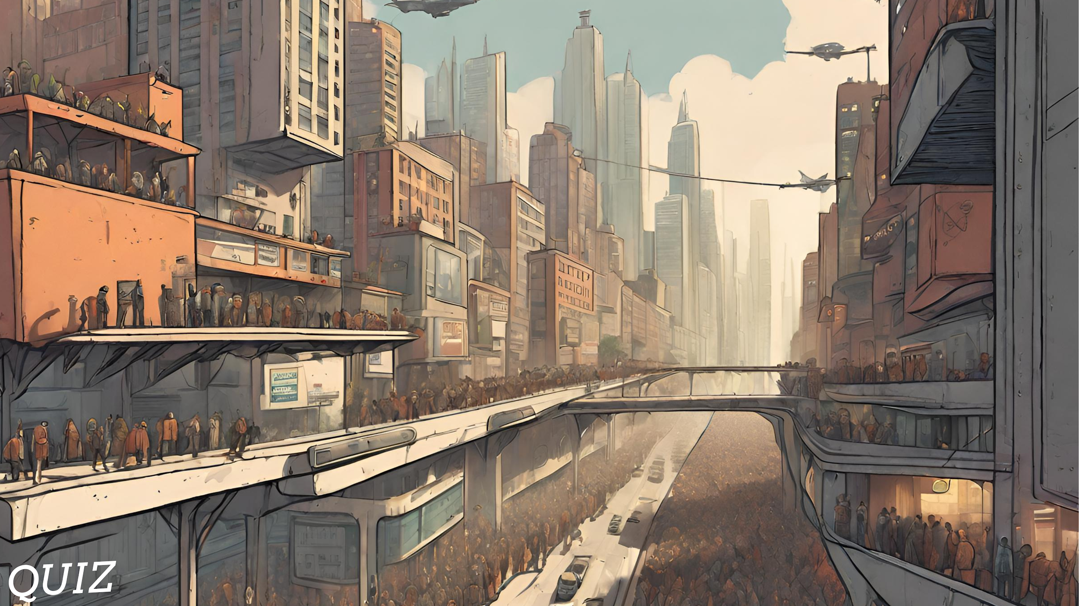

Slide 4
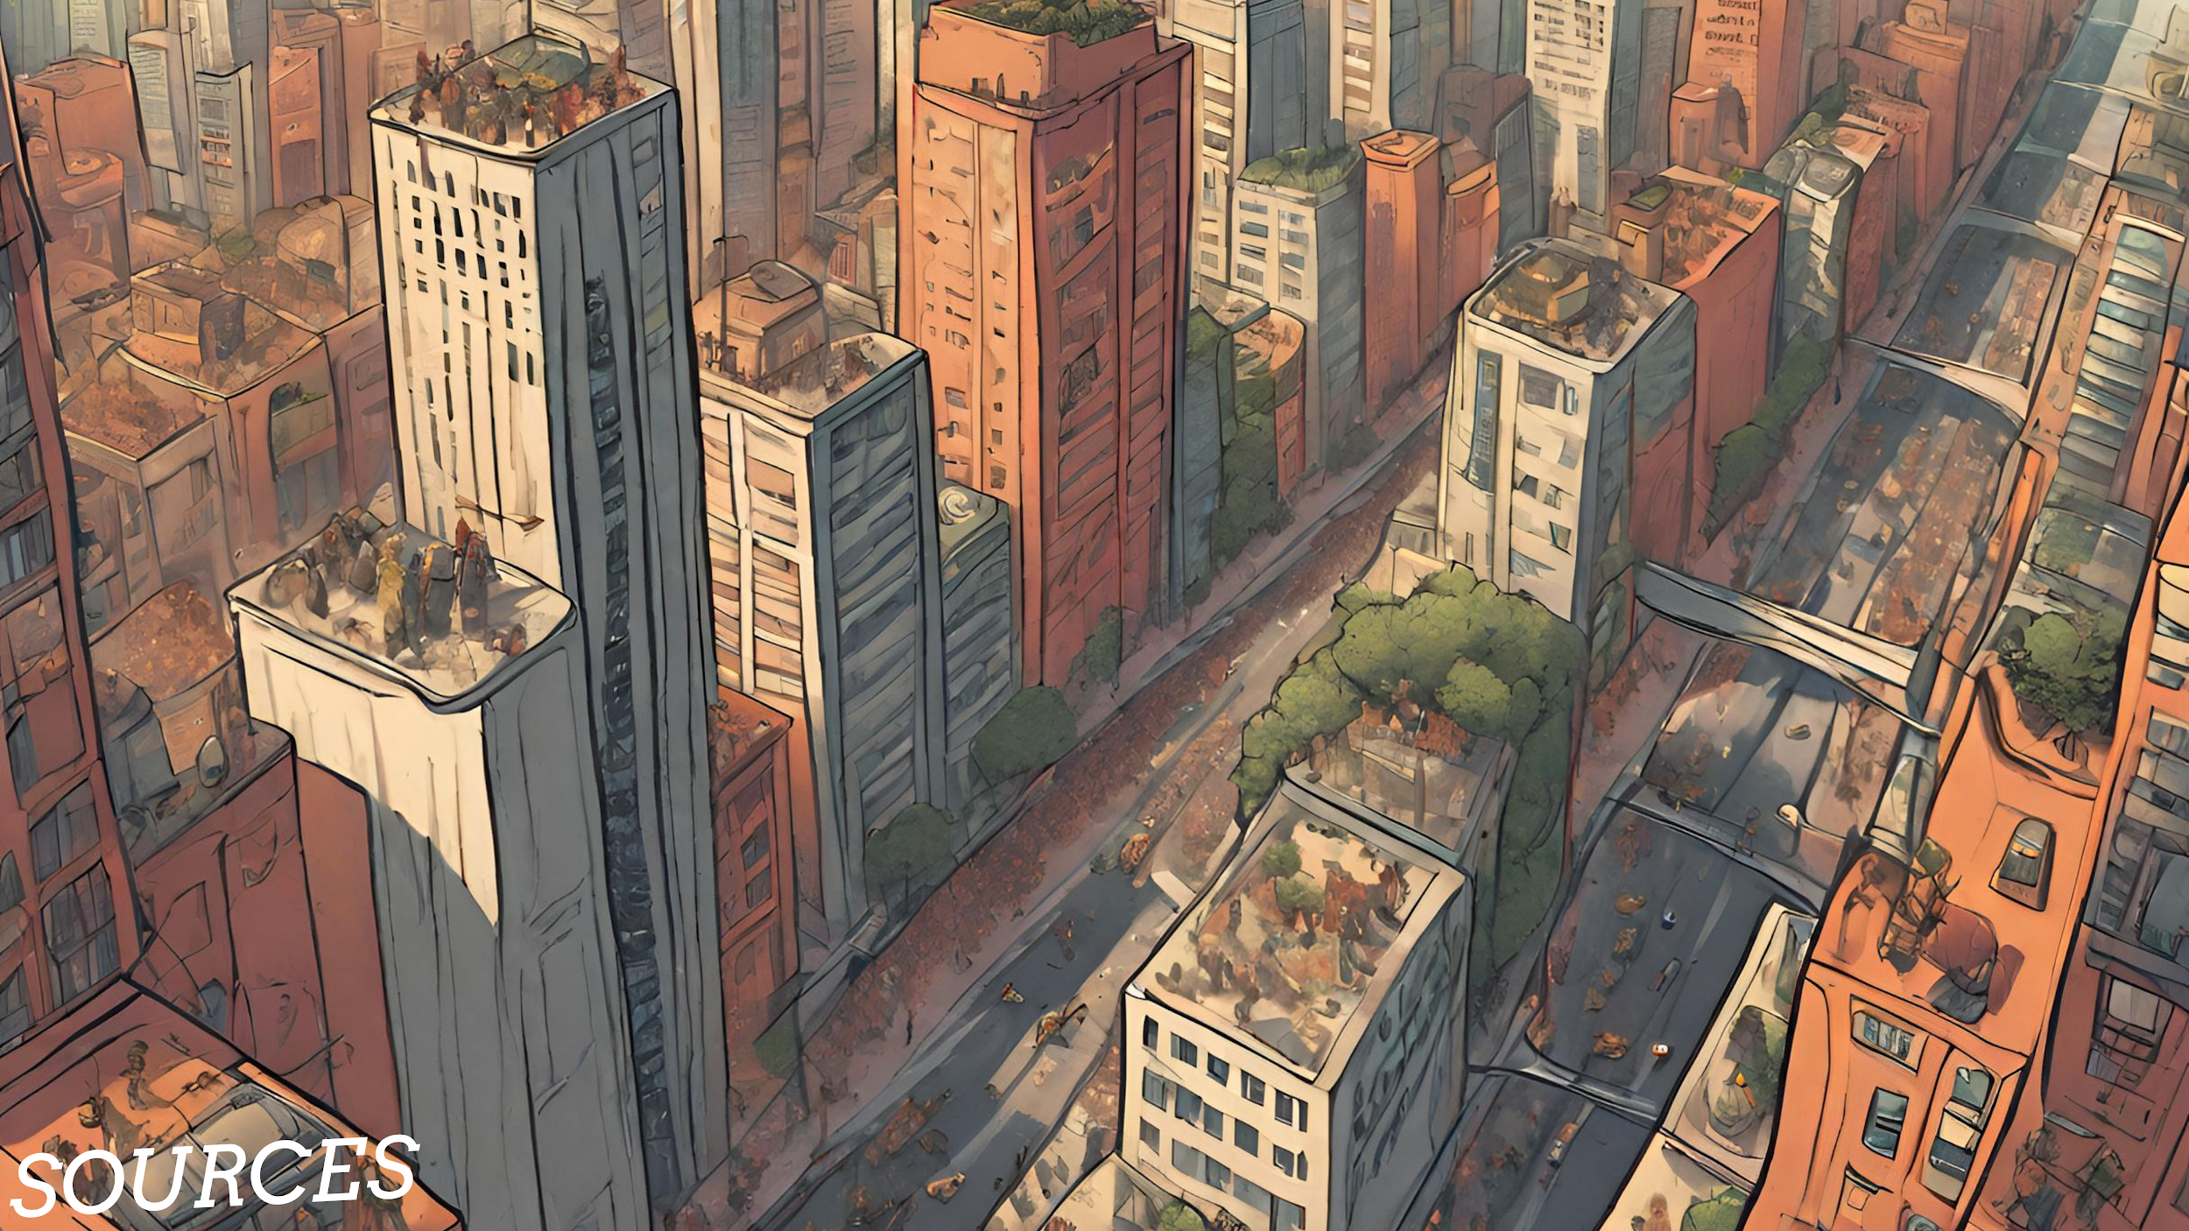
Source Goes Here
Source Goes Here
Source Goes Here
Source Goes Here
Source Goes Here

Slide 5


